Slide 1
Introduction to Computer Programming Lecture 8.3:
Curve Fitting
Hemma Philamore
Department of Engineering Mathematics

Slide 2
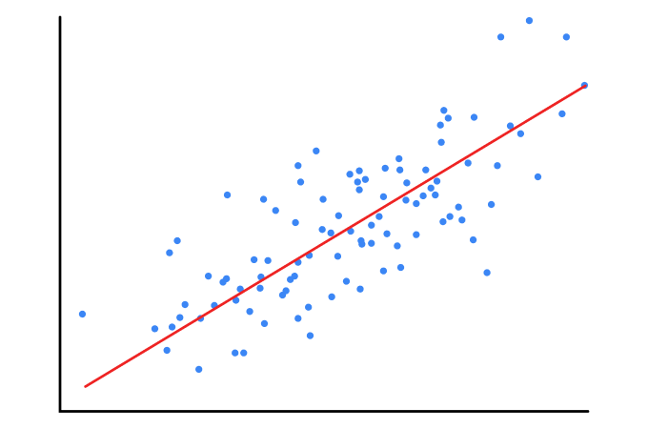
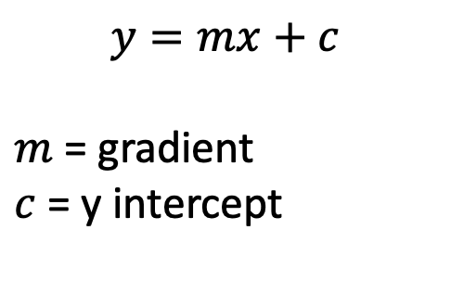


Linear Regression
$$y=mx+c$$
$m$ = gradient
$c$ = y intercept
$$y$$
$$x$$

Slide 3
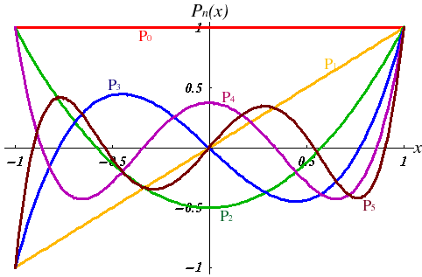
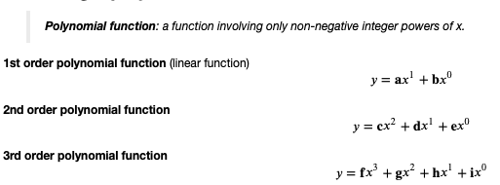
Fitting a Polynomial Function
Polynomial function: Only non-negative powers of $x$

Slide 4

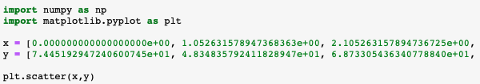
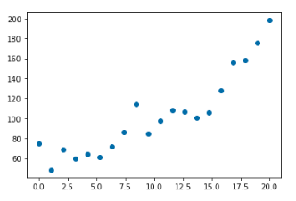
Fitting a Polynomial Function
Import required modules
Two lists (not all elements shown on this slide)
Scatter plot

Slide 5
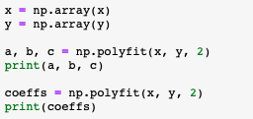
Fitting a Polynomial Function
Convert list to array for numpy operations
3 coefficients, 3 variables
3 coefficients, 1 data structure, 3 elements

Slide 6
polyfit: coefficients of polynomial
Convert list to array for numpy operations
3 coefficients, 3 variables
3 coefficients, 1 data structure, 3 elements

Slide 7
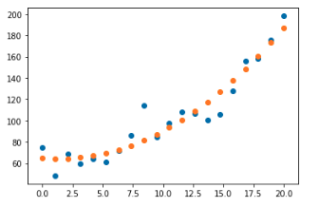
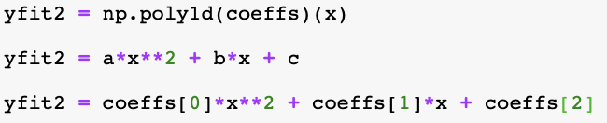

poly1d: generate fitted data
More efficient than typing polynomial equation
Array to fit values to

Slide 8
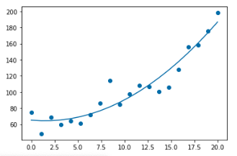
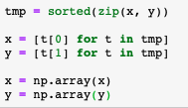

Monotonic x data
Sorts monotonically based on first variable
Split list of tuples using list comprehension

Slide 9
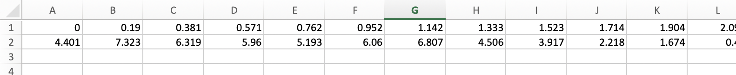
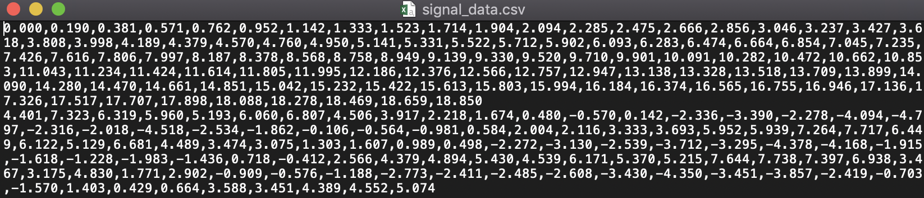
Importing data

Slide 10
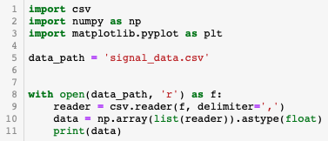
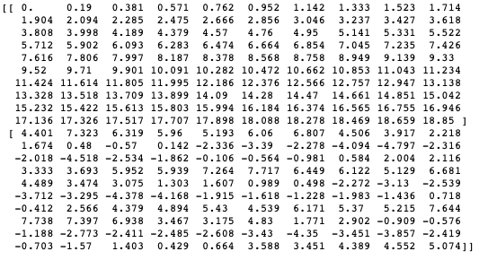
Importing data
File in current directory
Open as read only
Specify delimiter
Convert imported data to numpy array
2 rows,
100 columns

Slide 11
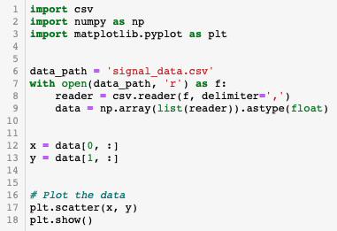
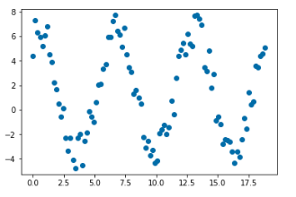
Importing data
Open as read only
Select the data of interest

Slide 12


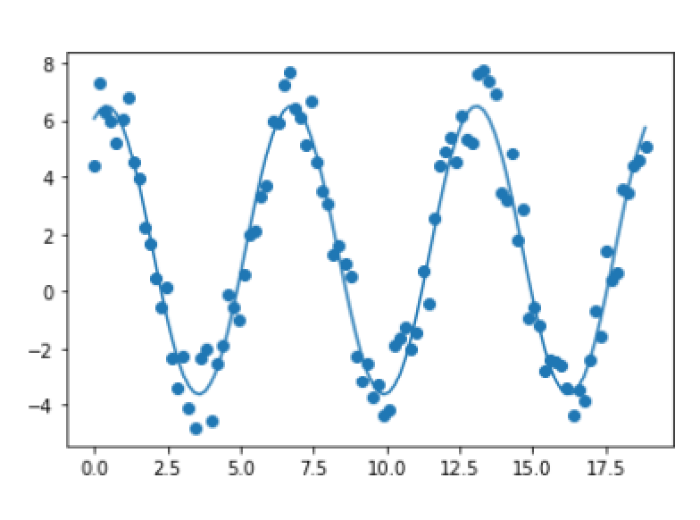

curve_fit: fit an arbitrary function
Define function with unknown constants
Function from scipy package
Two returned variables
* ‘unpacks’ the variable (to give 4 variabales in this case)

Slide 13
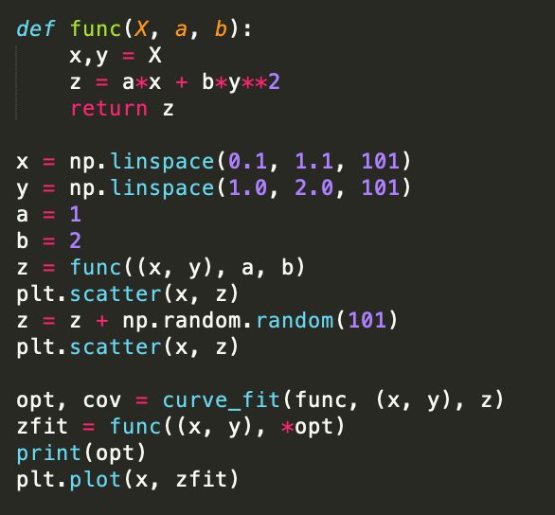
curve_fit: multiple variables
X is a data structure with two elements x, y
Generate some randomized data
Fit a curve using
Independent variables (x, y)
Dependent variable z

